Slide 1

CCPS530 - Web Systems Dev
Fareed Syed 500819438
Mechatronics Engineering (Major)
Computer Science(Minor)
LinkedIn: https://www.linkedin.com/in/fareed-syed/

Slide 2
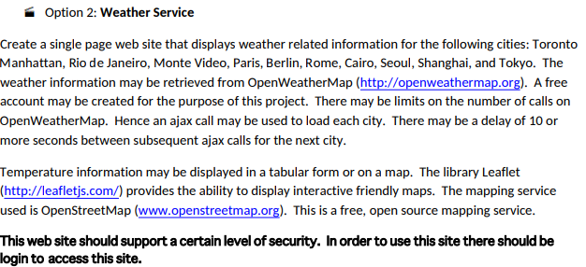
Weather Service Map

Slide 3
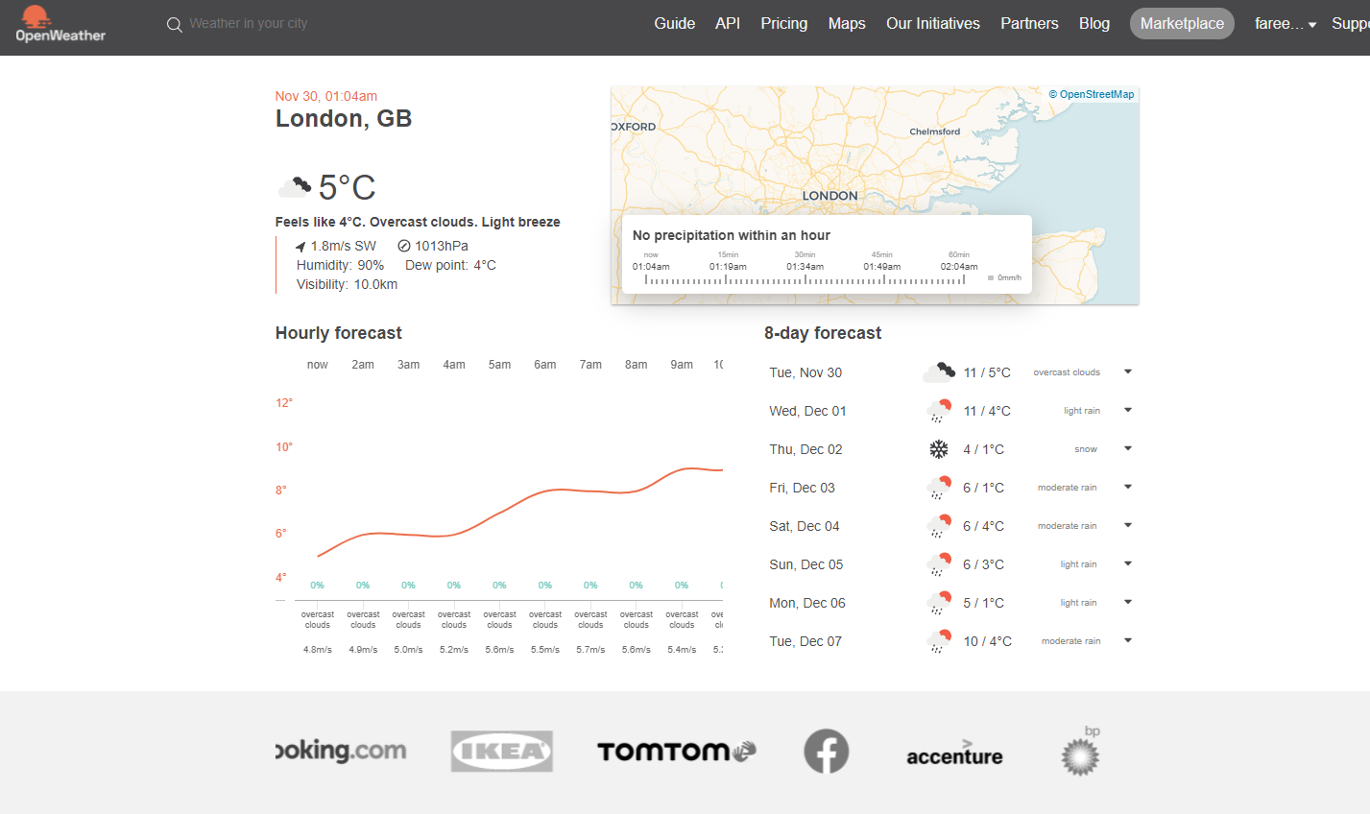
openweathermap.org

Slide 4
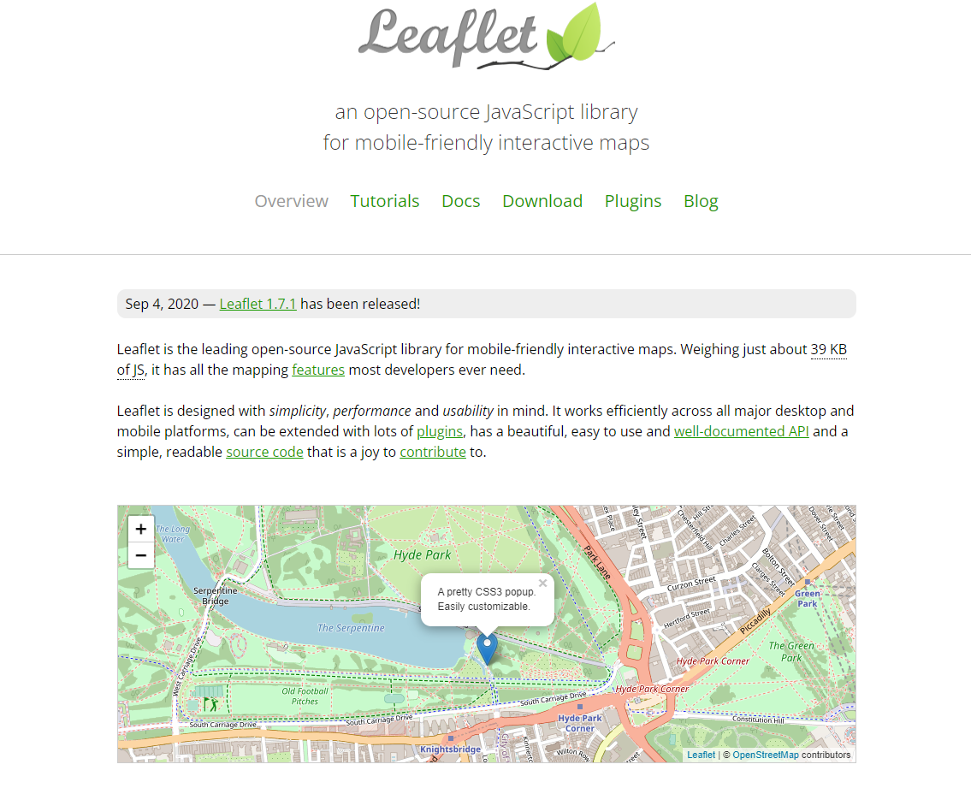

Slide 5
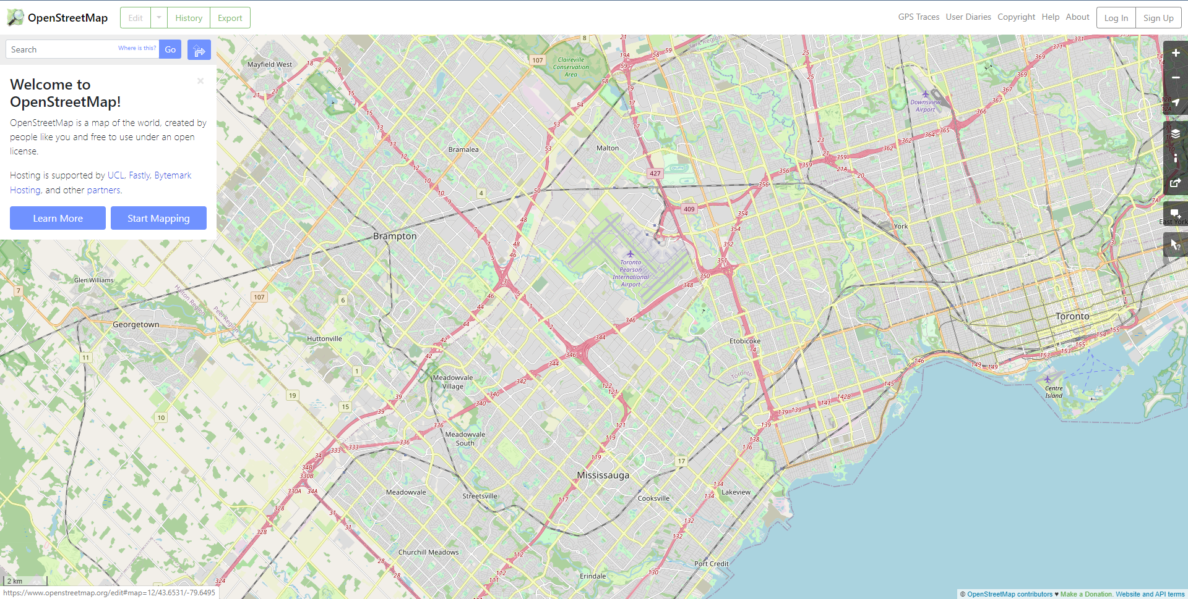

Slide 6
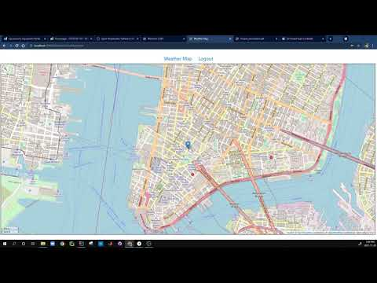
Switch to Live Demo

Slide 7
Project Summary
Runs on Node js server, localhost Port:3000
Not a user, sign up required
Already a user, login required
Search a city using search box top left
Click on the map to retrieve weather information
Log out once done

